Slide 1


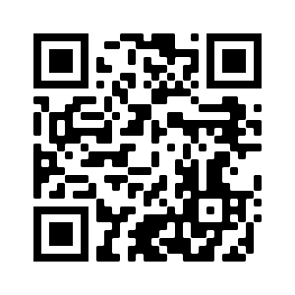





Introduction to Big Data Analysis
Big Data Analysis
1112BDA01
MBA, IM, NTPU (M6031) (Spring 2023) Tue 2, 3, 4 (9:10-12:00) (B8F40)
Min-Yuh Day, Ph.D, Associate Professor
Institute of Information Management, National Taipei University
https://web.ntpu.edu.tw/~myday
https://meet.google.com/paj-zhhj-mya
2023-02-21

Slide 2











Min-Yuh Day, Ph.D.
Associate Professor, Information Management, NTPU
Visiting Scholar, IIS, Academia Sinica
Ph.D., Information Management, NTU
Director, Intelligent Financial Innovation Technology, IFIT Lab, IM, NTPU
Artificial Intelligence, Financial Technology, Big Data Analytics, Data Mining and Text Mining, Electronic Commerce

Slide 3
Course Syllabus National Taipei University Academic Year 111, 2nd Semester (Spring 2023)
Course Title: Big Data Analysis
Instructor: Min-Yuh Day
Course Class: MBA, IM, NTPU (3 Credits, Elective)
Details
In-Class and Distance Learning EMI Course (3 Credits, Elective, One Semester) (M6031)
Time & Place: Tue, 2, 3, 4, (9:10-12:00) (B8F40)
Google Meet: https://meet.google.com/paj-zhhj-mya
https://meet.google.com/paj-zhhj-mya

Slide 4
Course Objectives
Understand the fundamental concepts and research issues of Big Data Analysis.
Equip with Hands-on practices of Big Data Analysis.
Conduct information systems research in the context of Big Data Analysis.

Slide 5
Course Outline
This course introduces the fundamental concepts, research issues, and hands-on practices of Big Data Analysis.
Topics include:
Introduction to Big Data Analysis
AI, Data Science and Big Data Analysis
Foundations of Big Data Analysis in Python
Machine Learning: SAS Viya, Data Preparation and Algorithm Selection
Machine Learning: Decision Trees and Ensembles of Trees
Machine Learning: Neural Networks (NN) and Support Vector Machines (SVM)
Machine Learning: Model Assessment and Deployment
ChatGPT and Large Language Models (LLM) for Big Data Analysis
Deep Learning for Finance Big Data Analysis
Case Study on Big Data Analysis

Slide 6
Core Competence
Exploring new knowledge in information technology, system development and application 80 %
Internet marketing planning ability 10 %
Thesis writing and independent research skills 10 %

Slide 7
Four Fundamental Qualities
Professionalism
Creative thinking and Problem-solving 40 %
Comprehensive Integration 40 %
Interpersonal Relationship
Communication and Coordination 10 %
Teamwork 5 %
Ethics
Honesty and Integrity 0 %
Self-Esteem and Self-reflection 0 %
International Vision
Caring for Diversity 0 %
Interdisciplinary Vision 5 %

Slide 8
College Learning Goals
Ethics/Corporate Social Responsibility
Global Knowledge/Awareness
Communication
Analytical and Critical Thinking

Slide 9
Department Learning Goals
Information Technologies and System Development Capabilities
Internet Marketing Management Capabilities
Research capabilities

Slide 10
Syllabus
Week Date Subject/Topics
1 2023/02/21 Introduction to Big Data Analysis
2 2023/02/28 (Day Off)
3 2023/03/07 AI, Data Science and Big Data Analysis
4 2023/03/14 Foundations of Big Data Analysis in Python
5 2023/03/21 Case Study on Big Data Analysis I
6 2023/03/28 Machine Learning: SAS Viya, Data Preparation and Algorithm Selection

Slide 11
Syllabus
Week Date Subject/Topics
7 2023/04/04 (Children's Day) (Day off)
8 2023/04/11 Midterm Project Report
9 2023/04/18 Machine Learning: Decision Trees and Ensembles of Trees
10 2023/04/25 Machine Learning: Neural Networks (NN) and Support Vector Machines (SVM)
11 2023/05/02 Case Study on Big Data Analysis II
12 2023/05/09 Machine Learning: Model Assessment and Deployment

Slide 12
Syllabus
Week Date Subject/Topics
13 2023/05/16 ChatGPT and Large Language Models (LLM) for Big Data Analysis
14 2023/05/23 Deep Learning for Finance Big Data Analysis
15 2023/05/30 Final Project Report I
16 2023/06/06 Final Project Report II
17 2023/06/13 Self-learning
18 2023/06/20 Self-learning

Slide 13
Teaching Methods and Activities
Lecture
Discussion
Practicum

Slide 14
Evaluation Methods
Individual Presentation 60 %
Group Presentation 10 %
Case Report 10 %
Class Participation 10 %
Assignment 10 %

Slide 15
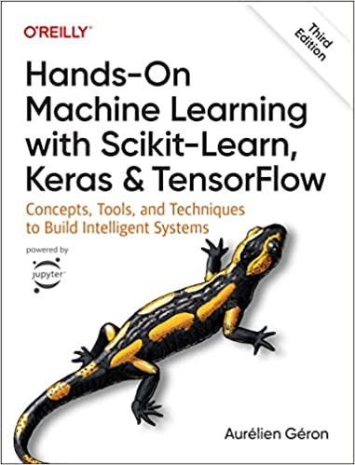
Required Texts
Aurélien Géron (2022), Hands-On Machine Learning with Scikit-Learn, Keras, and TensorFlow: Concepts, Tools, and Techniques to Build Intelligent Systems, 3rd Edition, O’Reilly Media.
Source: https://www.amazon.com/Hands-Machine-Learning-Scikit-Learn-TensorFlow/dp/1098125975

Slide 16
Reference Books
Yves Hilpisch (2018), Python for Finance: Mastering Data-Driven Finance, 2nd Edition, O'Reilly Media.
Yuxing Yan (2017), Python for Finance: Apply powerful finance models and quantitative analysis with Python, Second Edition, Packt Publishing

Slide 17
Other References
SAS (2023), Machine Learning Using SAS Viya
SAS (2023), 2023 SAS Machine Learning Academic Certification Program

Slide 18
Aurélien Géron (2022), Hands-On Machine Learning with Scikit-Learn, Keras, and TensorFlow: Concepts, Tools, and Techniques to Build Intelligent Systems, 3rd Edition, O’Reilly Media.
Source: https://www.amazon.com/Hands-Machine-Learning-Scikit-Learn-TensorFlow/dp/1098125975

Slide 19
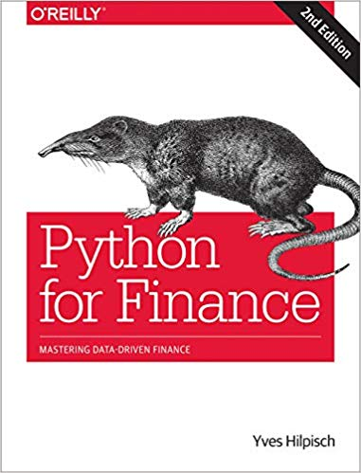
Yves Hilpisch (2018), Python for Finance: Mastering Data-Driven Finance, O'Reilly
Source: https://www.amazon.com/Python-Finance-Mastering-Data-Driven/dp/1492024333

Slide 20
Yuxing Yan (2017), Python for Finance: Apply powerful finance models and quantitative analysis with Python, Second Edition, Packt Publishing
Source: https://www.amazon.com/Python-Finance-powerful-quantitative-analysis/dp/1787125696

Slide 21
Social Network Based Big Data Analysis and Applications, Lecture Notes in Social Networks, Mehmet Kaya, Jalal Kawash, Suheil Khoury, Min-Yuh Day, Springer International Publishing, 2018.
Source: https://www.amazon.com/Network-Analysis-Applications-Lecture-Networks/dp/3319781952

Slide 22

2023 SAS Machine Learning Academic Certification Program SAS Viya

Slide 23
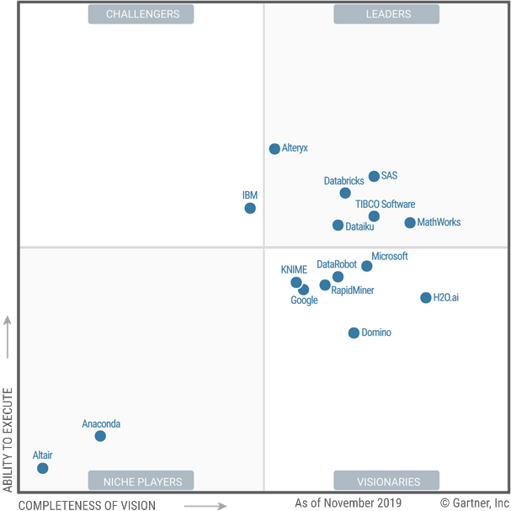


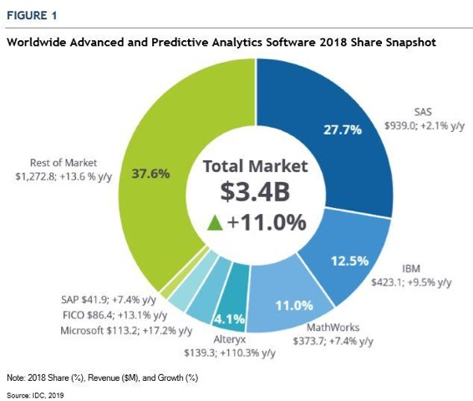
SAS．Leader in Analytics and AI
About SAS
SAS was founded in 1976
SAS has customers in nearly 150 countries
96 of the Top 100 of the 2017 Fortune 500 list are SAS customers or their affiliates.
12,170 total employees
SAS is investing $1 billion in artificial intelligence (AI) through software innovation, education, expert services and more.
For the 16th consecutive year, Gartner has positioned SAS as a Leader in the Magic Quadrant for Data Quality Solutions.
SAS ranks number one for market share, according to the IDC report

Slide 24

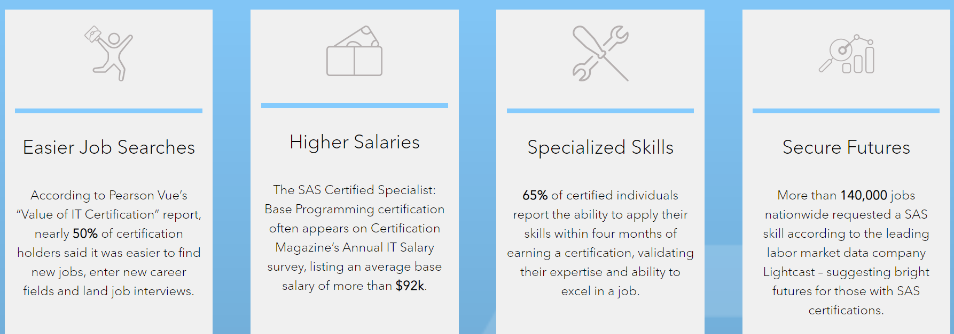
2023 SAS Machine Learning Academic Certification Program
Why SAS Certification?
SAS IS AMONG THE TOP 10 MOST IMPORTANT BIG DATA AND ANALYTICS CERTIFICATIONS IN 2021. – CIO Magazine
More than 219,000 jobs

Slide 25


2023 SAS Machine Learning Academic Certification Program
SAS AI Certification – Learning Path
Main certification
in this program
2
Forecasting and Optimization
+
1
Machine Learning Specialist
3
“AI & Machine Learning Professional”
Certified ModelOps Specialist
Candidates will be awarded the SAS Certified Professional: AI and Machine Learning once they have earned the SAS Certified Specialist: Machine Learning credential, the SAS Certified Specialist: Forecasting and Optimization and the SAS Certified Specialist: Natural Language Processing and Computer Vision.
Natural Language Processing and Computer Vision

Slide 26



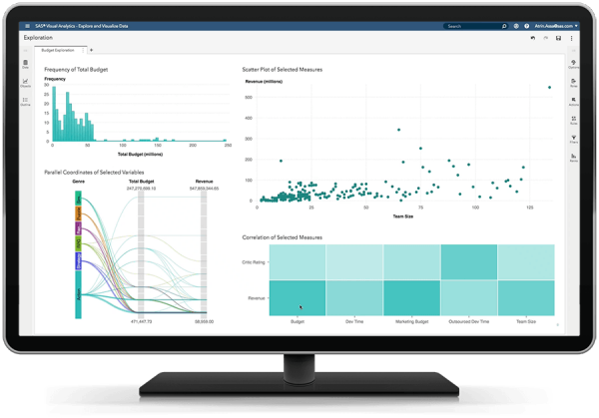
2023 SAS Machine Learning Academic Certification Program
Teaching and Learning Resource
For Teacher
For Student
Access to SAS Viya
Dataset
Tutorial
Instructor Materials
Access to SAS Viya
Dataset
Machine Learning Online Course (10h)
Exam Preparation Online Training (6h)
https://www.sas.com/en_us/software/viya-for-learners.html
Notes:
中英文影片 + 英文教材

Slide 27


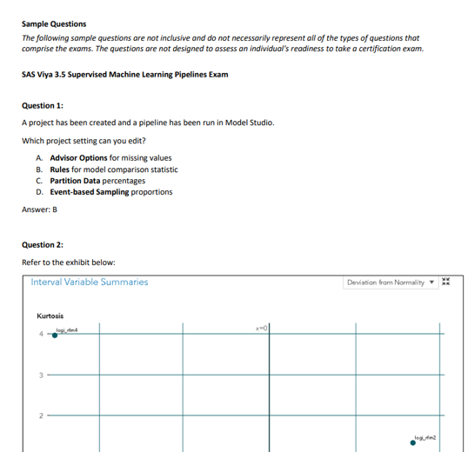
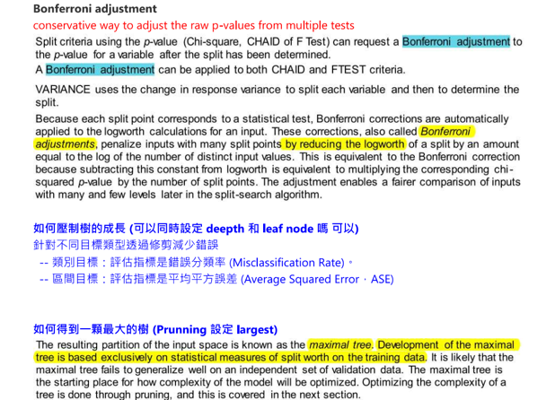
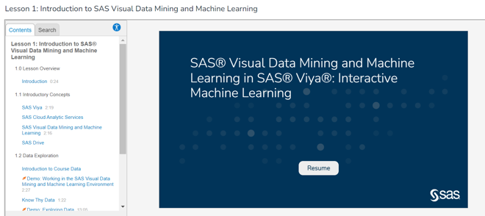
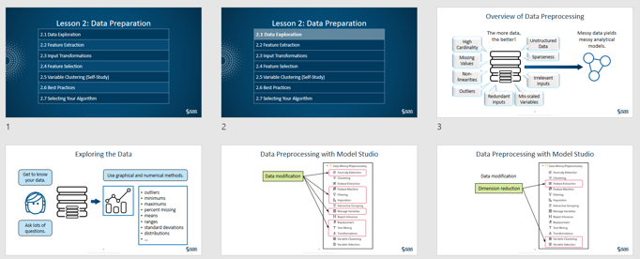
2023 SAS Machine Learning Academic Certification Program
Teaching and Learning Resource
1. Online Courses
2. Exam Preparation Training
Lesson 1: Introduction to SAS Visual Data Mining and Machine Learning
Lesson 2: Machine Learning Algorithms
Lesson 3: Ensemble Machine Learning Algorithms
Lesson 4: Model Assessment and Implementation
Lesson 5: Factorization Machines
Notes:
約10頁的提案

Slide 28


2023 SAS Machine Learning Academic Certification Program
Content
10-hour Machine Learning Online Courses
6-hour Exam Preparation Online Training
Access to SAS Viya
Practice Exam
Academic Discount NT$ 2,700
Certification Exam
Notes:
約10頁的提案

Slide 29
Big Data Analysis

Slide 30
AI, Big Data, Cloud Computing Evolution of Decision Support, Business Intelligence, and Analytics
AI
AI
Cloud Computing
Big Data
DM
BI
Source: Ramesh Sharda, Dursun Delen, and Efraim Turban (2017), Business Intelligence, Analytics, and Data Science: A Managerial Perspective, 4th Edition, Pearson

Slide 31
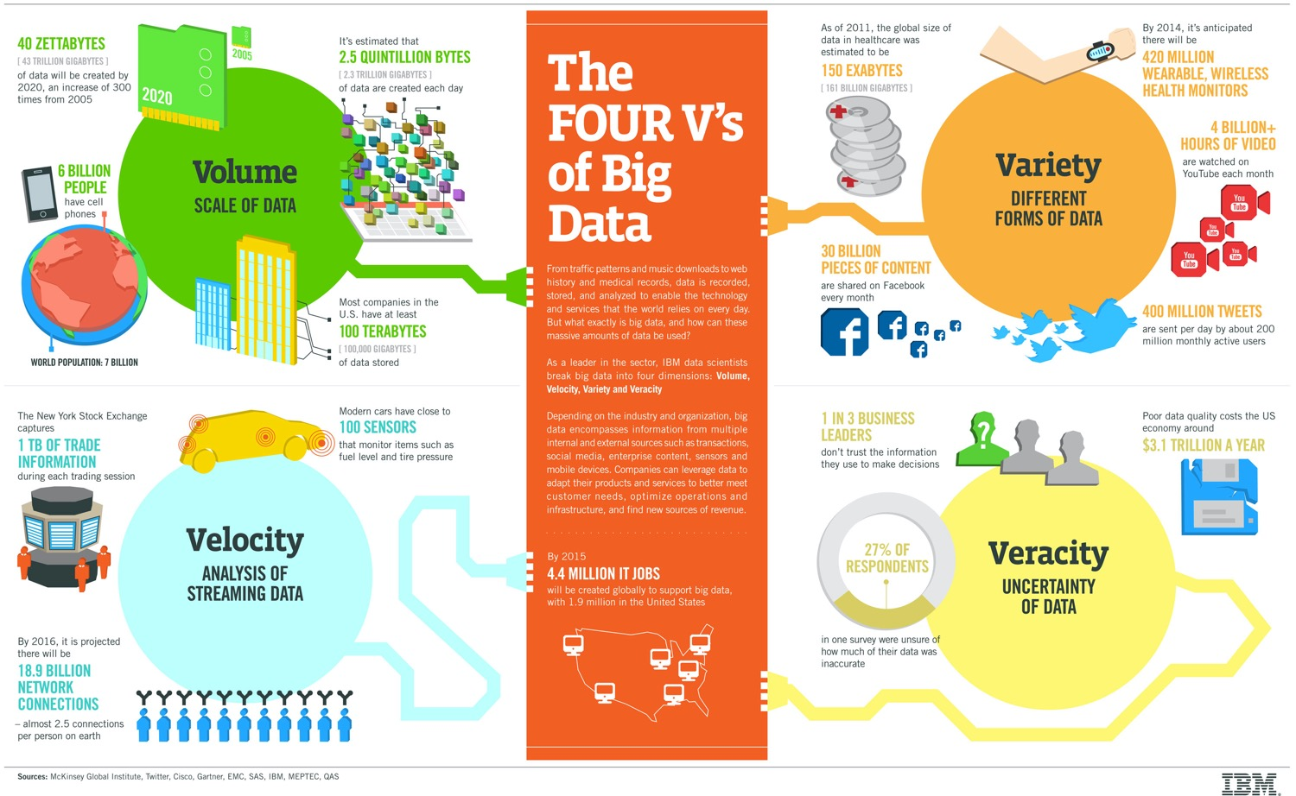
Big Data 4 V
Source: https://www-01.ibm.com/software/data/bigdata/

Slide 32
Value

Slide 33
Artificial Intelligence Machine Learning & Deep Learning
Source: https://blogs.nvidia.com/blog/2016/07/29/whats-difference-artificial-intelligence-machine-learning-deep-learning-ai/

Slide 34
AI, ML, DL
Artificial Intelligence (AI)
Machine Learning (ML)
Supervised Learning
Unsupervised Learning
Deep Learning (DL)
CNN
RNN LSTM GRU
GAN
Semi-supervised Learning
Reinforcement Learning
Source: https://leonardoaraujosantos.gitbooks.io/artificial-inteligence/content/deep_learning.html

Slide 35
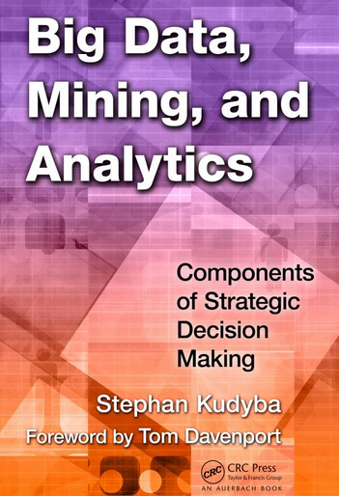
Stephan Kudyba (2014), Big Data, Mining, and Analytics: Components of Strategic Decision Making, Auerbach Publications
Source: http://www.amazon.com/gp/product/1466568704

Slide 36
Architecture of Big Data Analytics
Big Data Analytics Applications
Big Data Sources
Big Data Transformation
Big Data Platforms & Tools
* Internal
* External
* Multiple formats
* Multiple locations
* Multiple applications
Middleware
Hadoop
MapReduce
Pig
Hive
Jaql
Zookeeper
Hbase
Cassandra
Oozie
Avro
Mahout
Others
Queries
Raw Data
Transformed Data
Big Data Analytics
Extract Transform Load
Reports
Data Warehouse
OLAP
Traditional Format CSV, Tables
Data Mining
Source: Stephan Kudyba (2014), Big Data, Mining, and Analytics: Components of Strategic Decision Making, Auerbach Publications

Slide 37
Architecture of Big Data Analytics
Big Data Analytics Applications
Big Data Sources
Big Data Transformation
Big Data Platforms & Tools
* Internal
* External
* Multiple formats
* Multiple locations
* Multiple applications
Data Mining
Big Data Analytics Applications
Middleware
Hadoop
MapReduce
Pig
Hive
Jaql
Zookeeper
Hbase
Cassandra
Oozie
Avro
Mahout
Others
Queries
Raw Data
Transformed Data
Big Data Analytics
Extract Transform Load
Reports
Data Warehouse
OLAP
Traditional Format CSV, Tables
Data Mining
Source: Stephan Kudyba (2014), Big Data, Mining, and Analytics: Components of Strategic Decision Making, Auerbach Publications

Slide 38
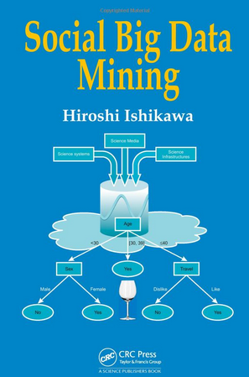
Social Big Data Mining (Hiroshi Ishikawa, 2015)
Source: http://www.amazon.com/Social-Data-Mining-Hiroshi-Ishikawa/dp/149871093X

Slide 39
Architecture for Social Big Data Mining (Hiroshi Ishikawa, 2015)
Enabling Technologies
Analysts
Integrated analysis
Integrated analysis model
Model Construction
Explanation by Model
Conceptual Layer
Natural Language Processing
Information Extraction
Anomaly Detection
Discovery of relationships among heterogeneous data
Large-scale visualization
Construction and confirmation of individual hypothesis
Description and execution of application-specific task
Data Mining
Multivariate analysis
Application specific task
Logical Layer
Parallel distrusted processing
Software
Social Data
Hardware
Physical Layer
Source: Hiroshi Ishikawa (2015), Social Big Data Mining, CRC Press

Slide 40
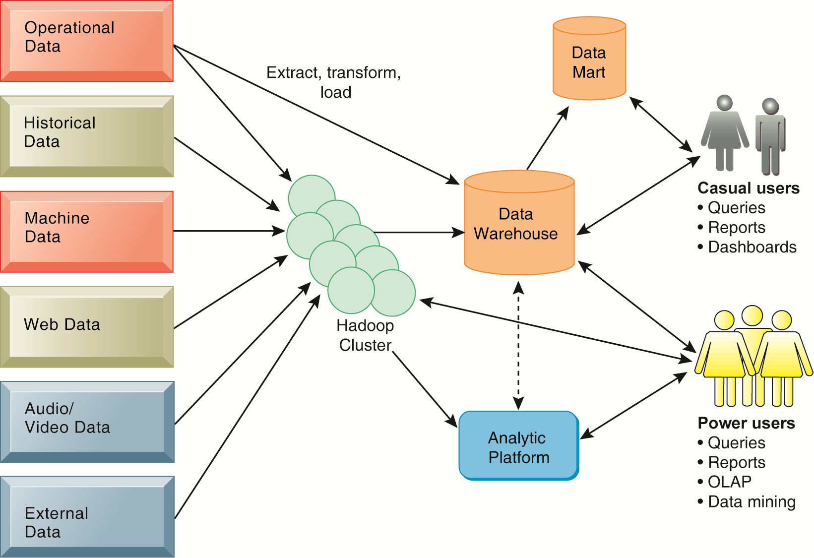
Business Intelligence (BI) Infrastructure

Slide 41
Data Warehouse Data Mining and Business Intelligence
Increasing potential
to support
business decisions
End User
Decision Making
Data Presentation
Business
Analyst
Visualization Techniques
Data Mining
Data
Analyst
Information Discovery
Data Exploration
Statistical Summary, Querying, and Reporting
Data Preprocessing/Integration, Data Warehouses
Data Sources
DBA
Paper, Files, Web documents, Scientific experiments, Database Systems
Source: Jiawei Han and Micheline Kamber (2006), Data Mining: Concepts and Techniques, Second Edition, Elsevier

Slide 42
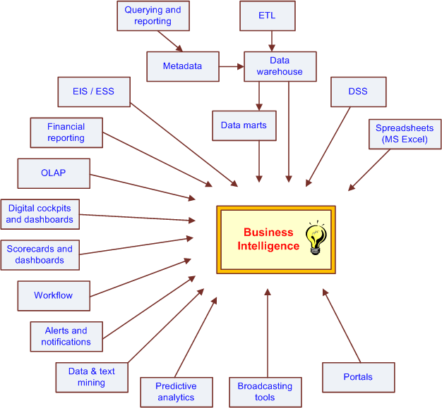
The Evolution of BI Capabilities
Source: Turban et al. (2011), Decision Support and Business Intelligence Systems

Slide 43
Three Types of Analytics
Source: Ramesh Sharda, Dursun Delen, and Efraim Turban (2017), Business Intelligence, Analytics, and Data Science: A Managerial Perspective, 4th Edition, Pearson

Slide 44
Big Data, Data Mining, and Machine Learning: Value Creation for Business Leaders and Practitioners, Jared Dean, Wiley, 2014.
Source: https://www.amazon.com/Data-Mining-Machine-Learning-Practitioners/dp/1118618041

Slide 45
Data Mining at the Intersection of Many Disciplines
Source: Turban et al. (2011), Decision Support and Business Intelligence Systems

Slide 46
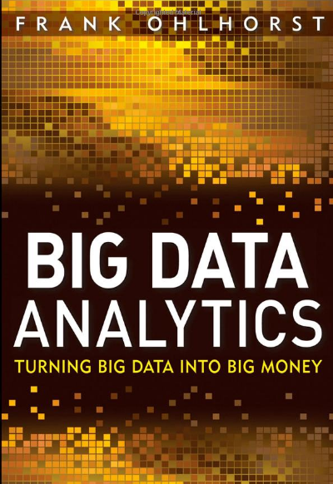
Source: http://www.amazon.com/Big-Data-Analytics-Turning-Money/dp/1118147596

Slide 47
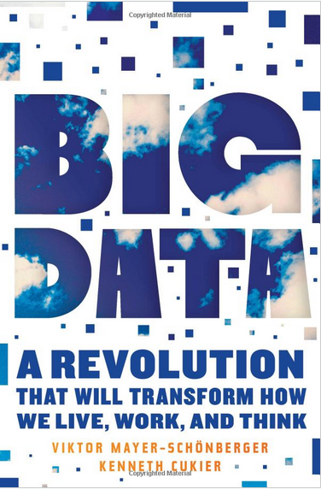
Source: http://www.amazon.com/Big-Data-Revolution-Transform-Mayer-Schonberger/dp/B00D81X2YE

Slide 48
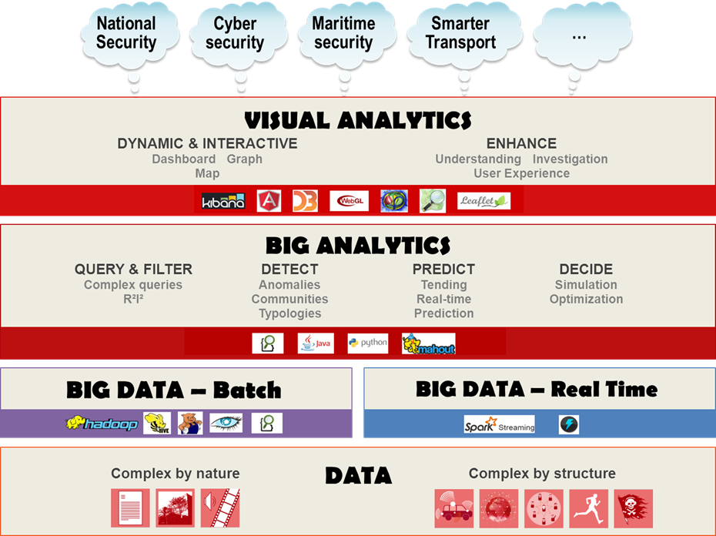
Source: https://www.thalesgroup.com/en/worldwide/big-data/big-data-big-analytics-visual-analytics-what-does-it-all-mean

Slide 49
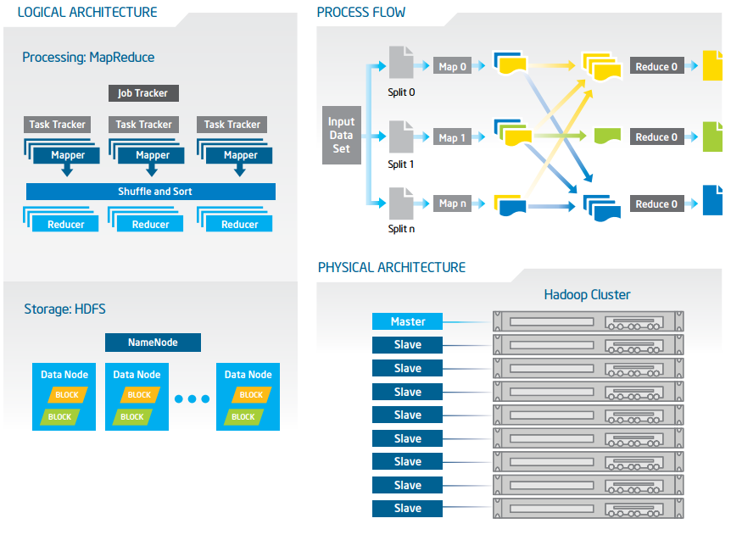
Big Data with Hadoop Architecture
Source: https://software.intel.com/sites/default/files/article/402274/etl-big-data-with-hadoop.pdf

Slide 50
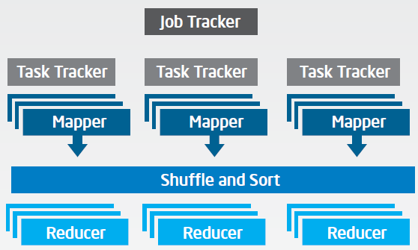
Big Data with Hadoop Architecture Logical Architecture Processing: MapReduce
Source: https://software.intel.com/sites/default/files/article/402274/etl-big-data-with-hadoop.pdf

Slide 51
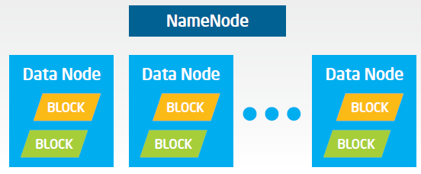
Big Data with Hadoop Architecture Logical Architecture Storage: HDFS
Source: https://software.intel.com/sites/default/files/article/402274/etl-big-data-with-hadoop.pdf

Slide 52
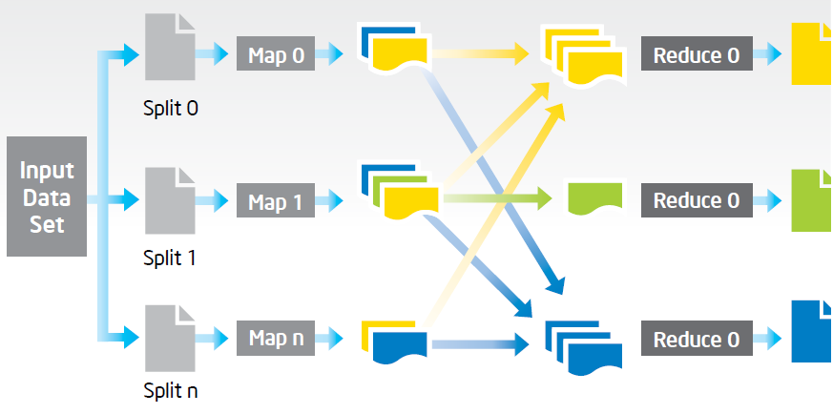
Big Data with Hadoop Architecture Process Flow
Source: https://software.intel.com/sites/default/files/article/402274/etl-big-data-with-hadoop.pdf

Slide 53
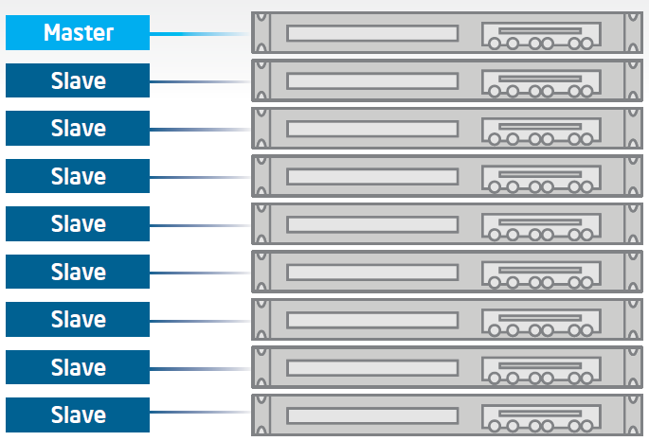
Big Data with Hadoop Architecture Hadoop Cluster
Source: https://software.intel.com/sites/default/files/article/402274/etl-big-data-with-hadoop.pdf

Slide 54
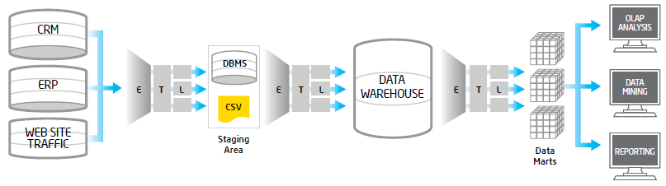
Traditional ETL Architecture
Source: https://software.intel.com/sites/default/files/article/402274/etl-big-data-with-hadoop.pdf

Slide 55
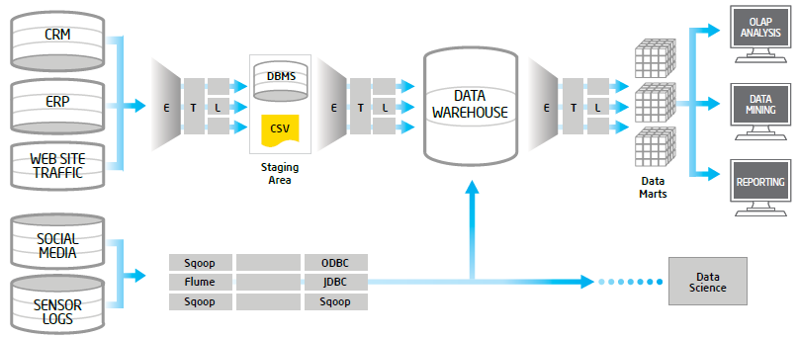
Offload ETL with Hadoop (Big Data Architecture)
Source: https://software.intel.com/sites/default/files/article/402274/etl-big-data-with-hadoop.pdf

Slide 56
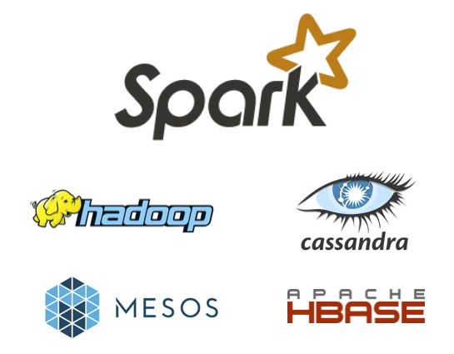
Spark and Hadoop
Source: http://spark.apache.org/

Slide 57
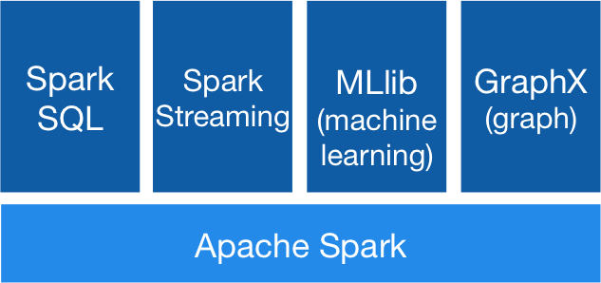
Spark Ecosystem
Source: http://spark.apache.org/

Slide 58
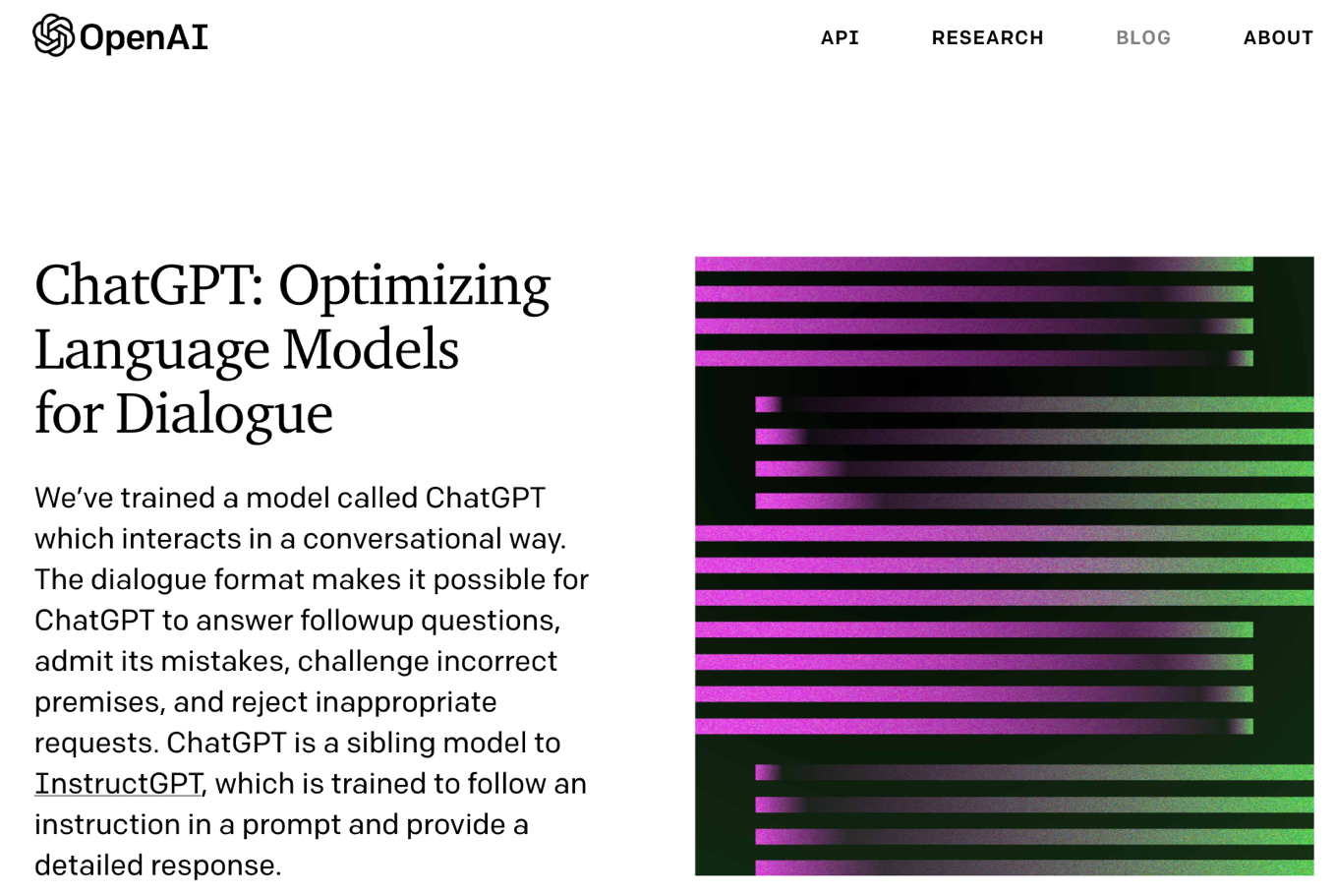
OpenAI ChatGPT
Source: https://openai.com/blog/chatgpt/

Slide 59
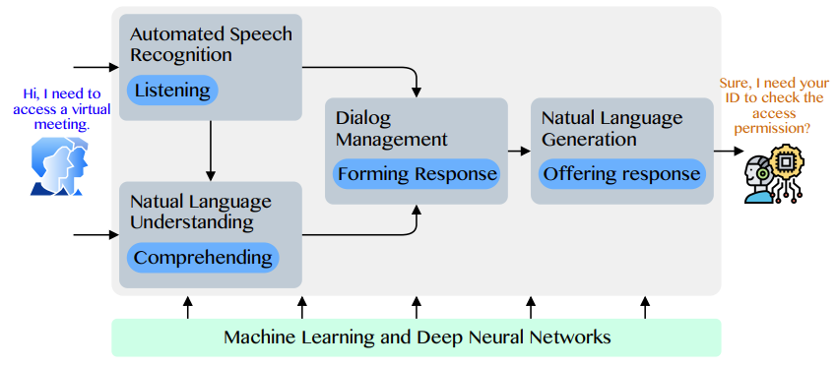
Conversational AI to deliver contextual and personal experience to users
Source: Huynh-The, Thien, Quoc-Viet Pham, Xuan-Qui Pham, Thanh Thi Nguyen, Zhu Han, and Dong-Seong Kim (2022). "Artificial Intelligence for the Metaverse: A Survey." arXiv preprint arXiv:2202.10336.

Slide 60
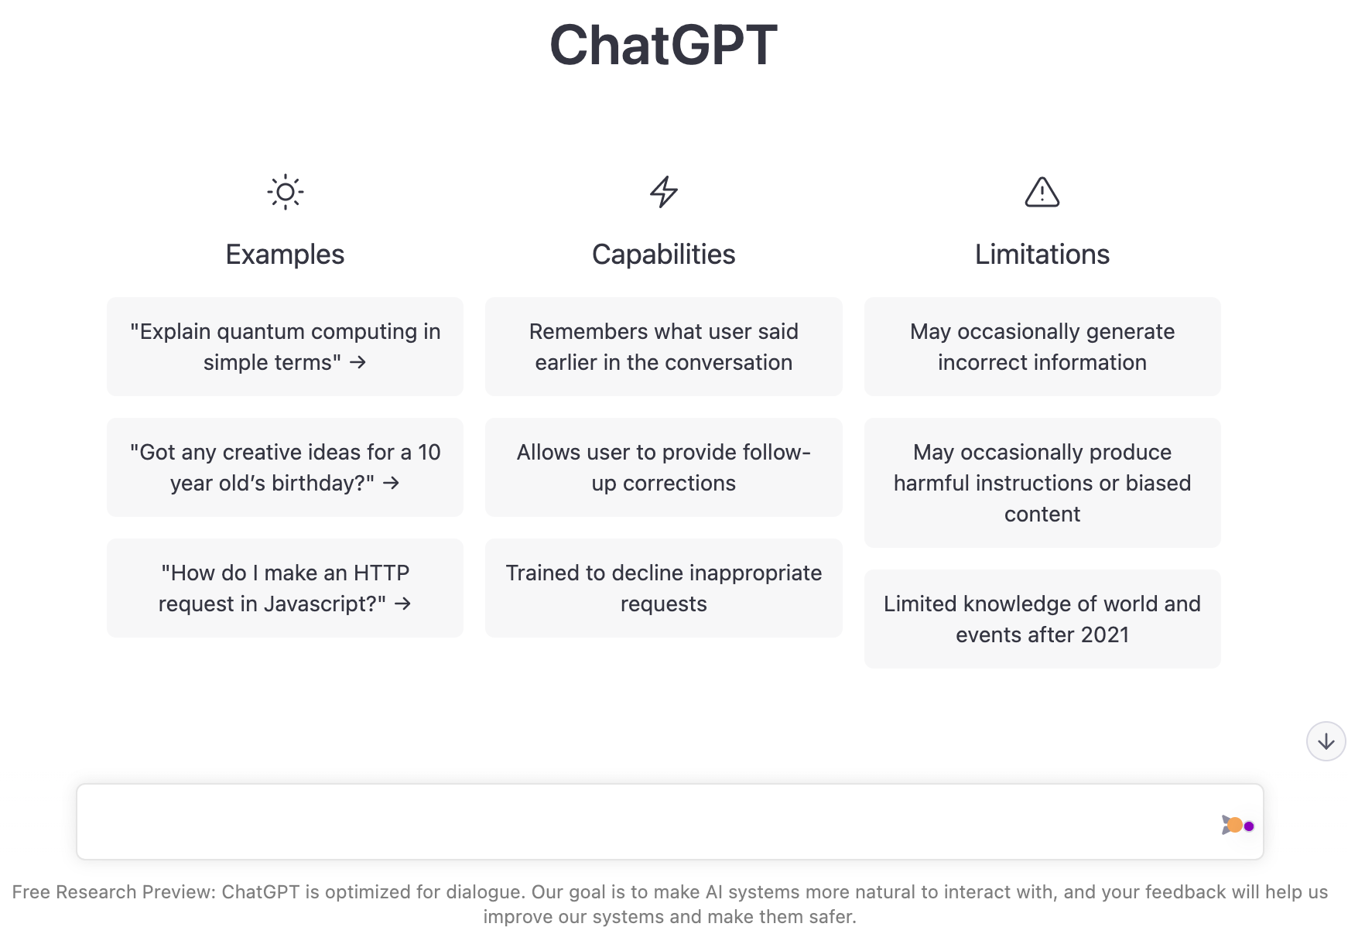
OpenAI ChatGPT
Source: https://chat.openai.com/chat

Slide 61
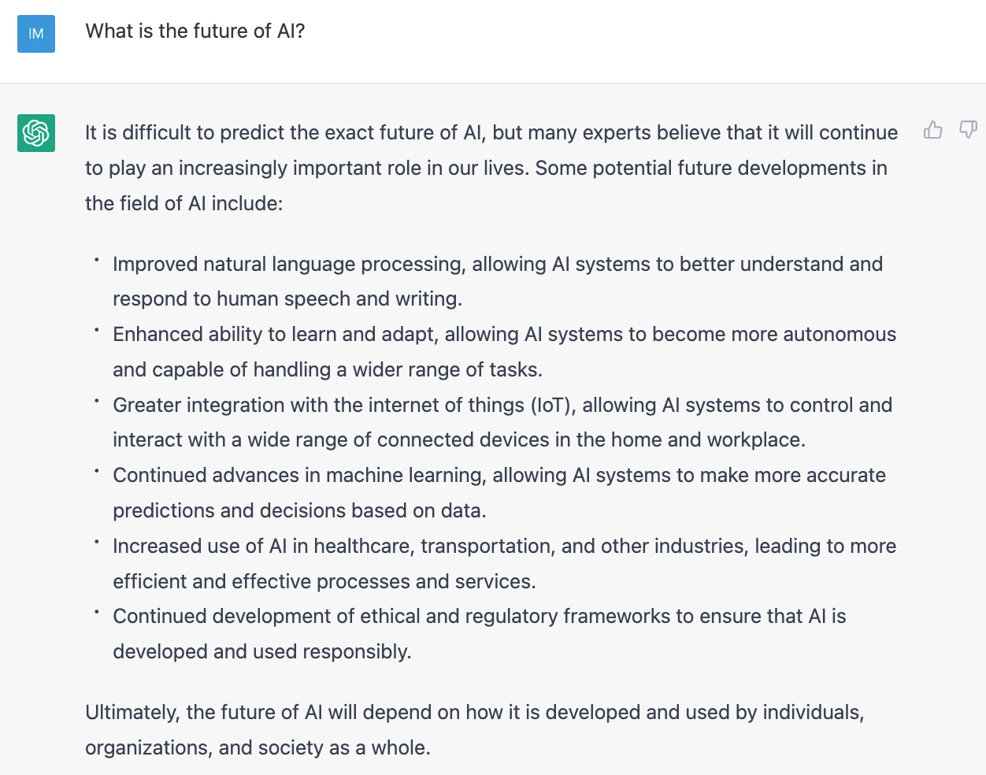
OpenAI ChatGPT
Source: https://chat.openai.com/chat

Slide 62
The Transformers Timeline
ULMFit
BERT
RoBERTa
XLM-R
DeBERTa
GPT-Neo
BLOOM
DistrilBERT
T5
PaLM
ChatGPT
Transformer
GPT
GPT-2
GPT-3
GPT-J
OPT-175B
LLaMA
2017
2018
2019
2020
2021
2022
2023
Source: Lewis Tunstall, Leandro von Werra, and Thomas Wolf (2022), Natural Language Processing with Transformers: Building Language Applications with Hugging Face, O'Reilly Media.

Slide 63
Transformer Models
Transformer
Encoder
Decoder
DistilBERT
BERT
T5
GPT
RoBERTa
BART
GPT-2
CTRL
XLM-R
XLM
M2M-100
GPT-3
ALBERT
BigBird
GPT-Neo
GPT-J
ELECTRA
mT0
BLOOM
BLOOMZ
DeBERTa
ChatGPT
Source: Lewis Tunstall, Leandro von Werra, and Thomas Wolf (2022), Natural Language Processing with Transformers: Building Language Applications with Hugging Face, O'Reilly Media.

Slide 64
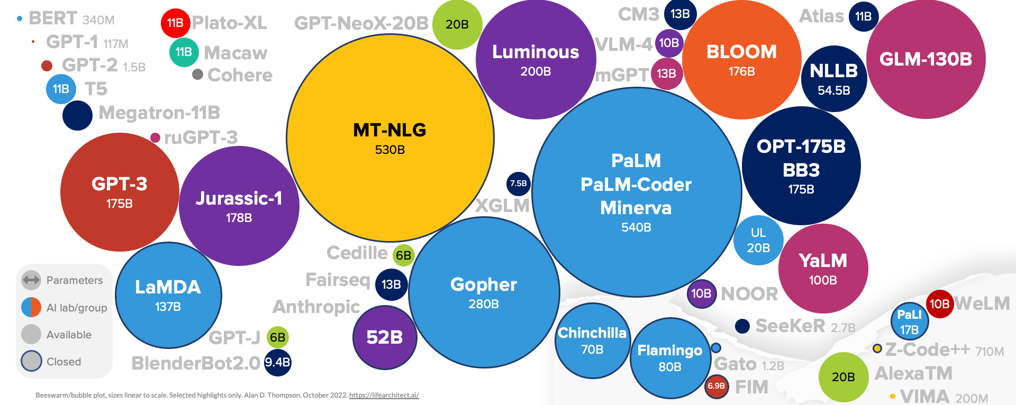
Large Language Models (LLM) (GPT-3, ChatGPT, PaLM, BLOOM, OPT-175B, LLaMA)
ChatGPT
175B
LLaMA
65B
Source: https://lifearchitect.ai/models/

Slide 65
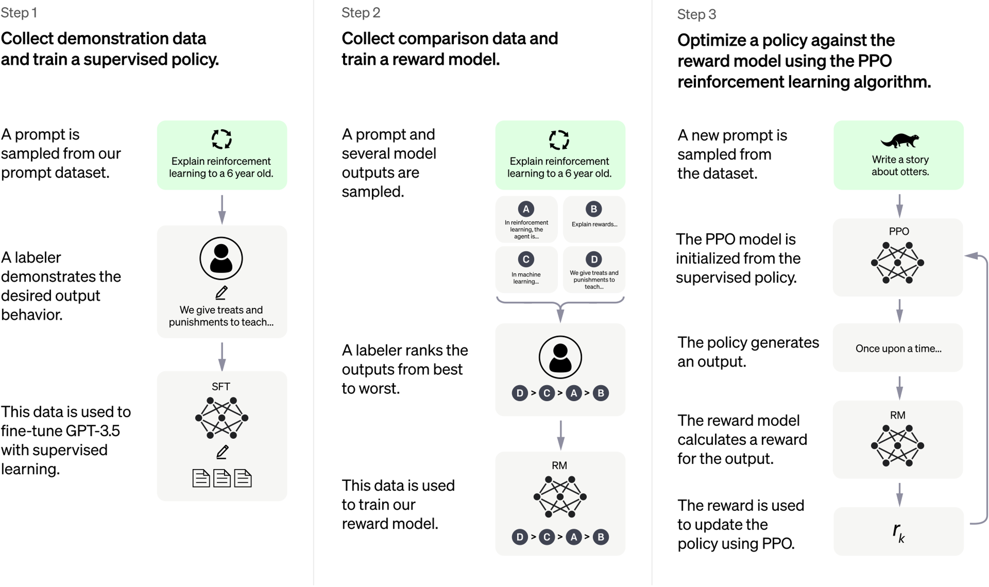
ChatGPT: Optimizing Language Models for Dialogue
Source: https://openai.com/blog/chatgpt/

Slide 66
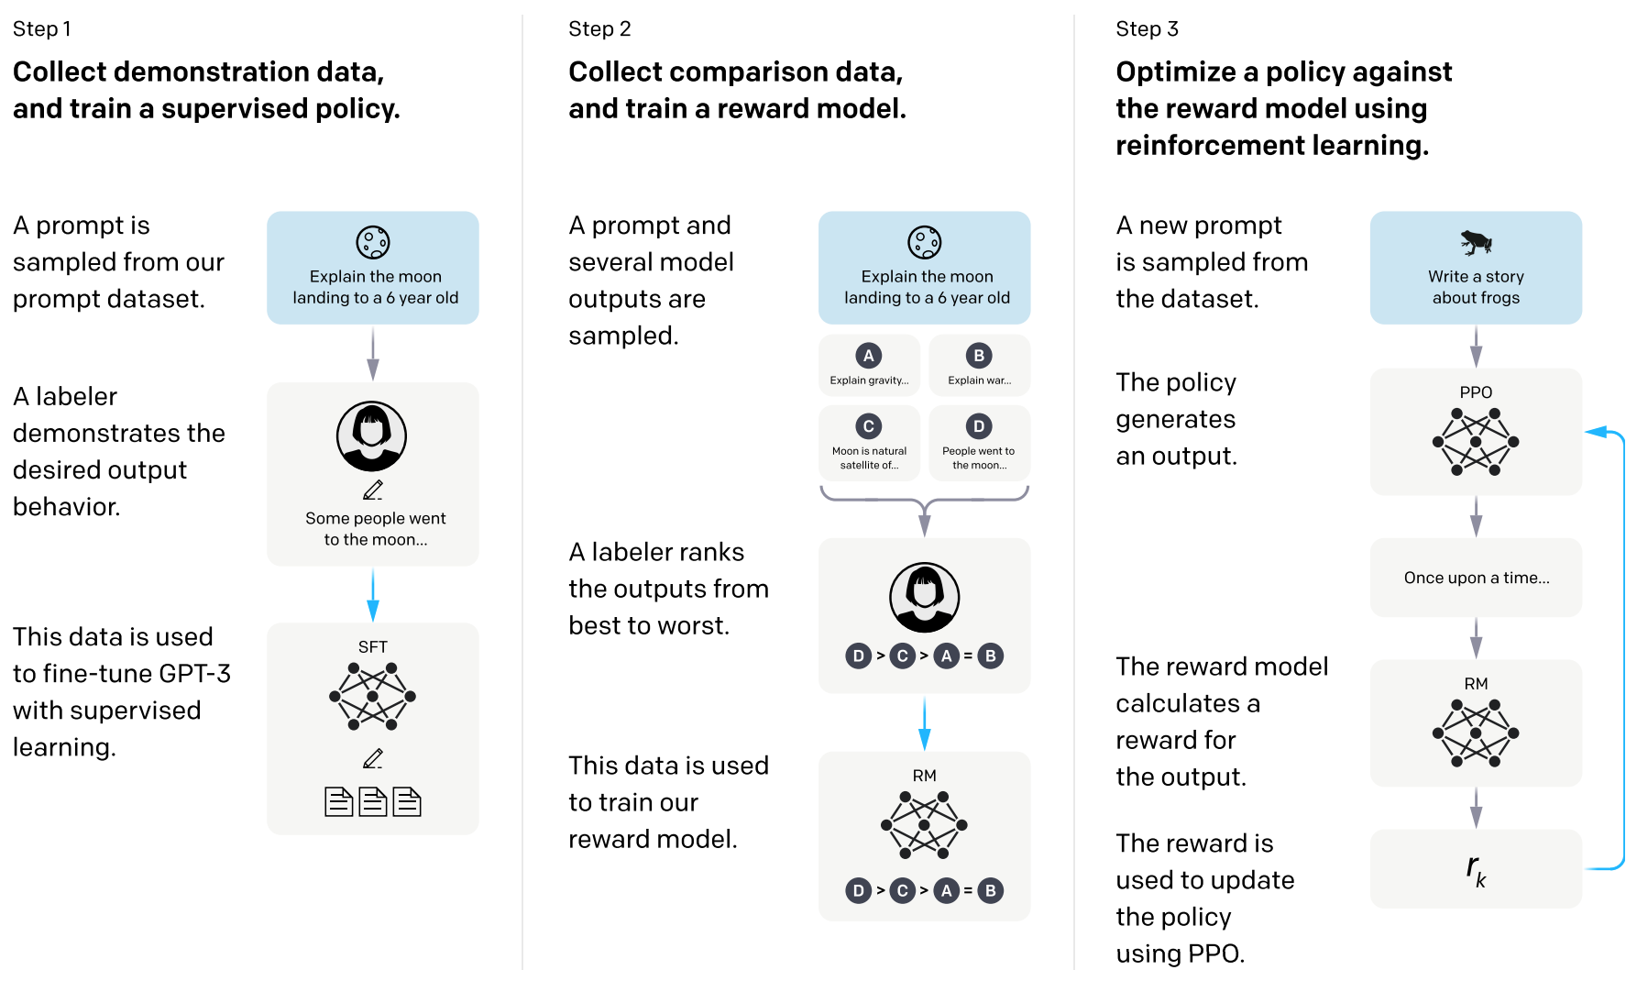
Training language models to follow instructions with human feedback
InstructGPT and GPT 3.5
Source: Ouyang, L., Wu, J., Jiang, X., Almeida, D., Wainwright, C. L., Mishkin, P., ... & Lowe, R. (2022). Training language models to follow instructions with human feedback. arXiv preprint arXiv:2203.02155.

Slide 67
Reinforcement Learning from Human Feedback (RLHF)
Pretraining a Language Model (LM)
Gathering Data and Training a Reward Model
Fine-tuning the LM with Reinforcement Learning
Source: https://huggingface.co/blog/rlhf

Slide 68
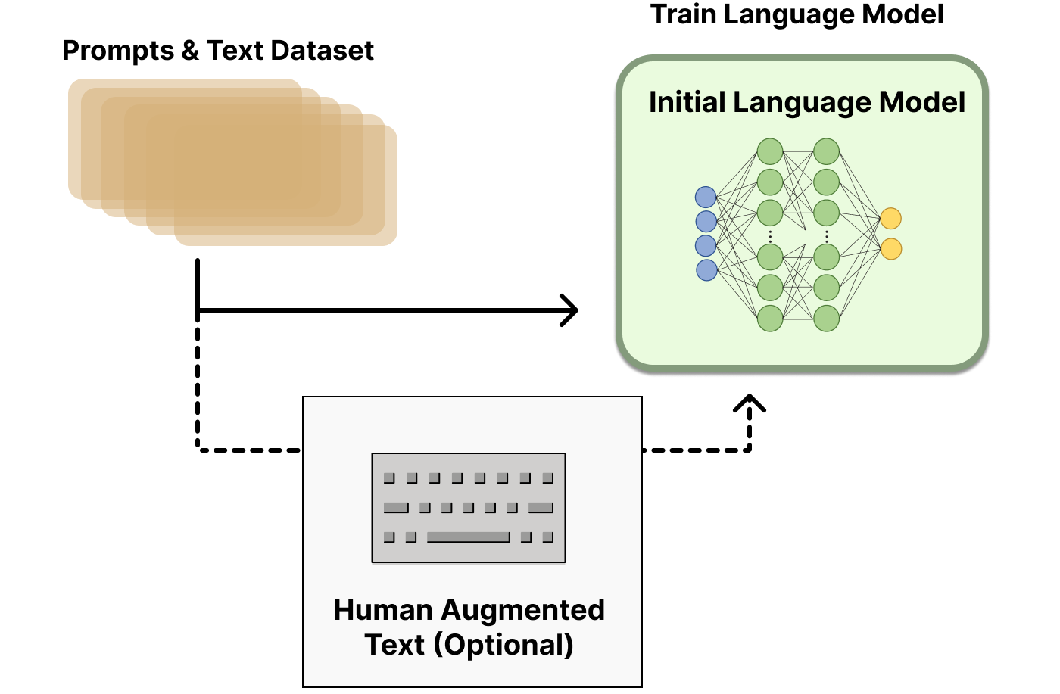
Reinforcement Learning from Human Feedback (RLHF) Step 1. Pretraining a Language Model (LM)
Source: https://huggingface.co/blog/rlhf

Slide 69
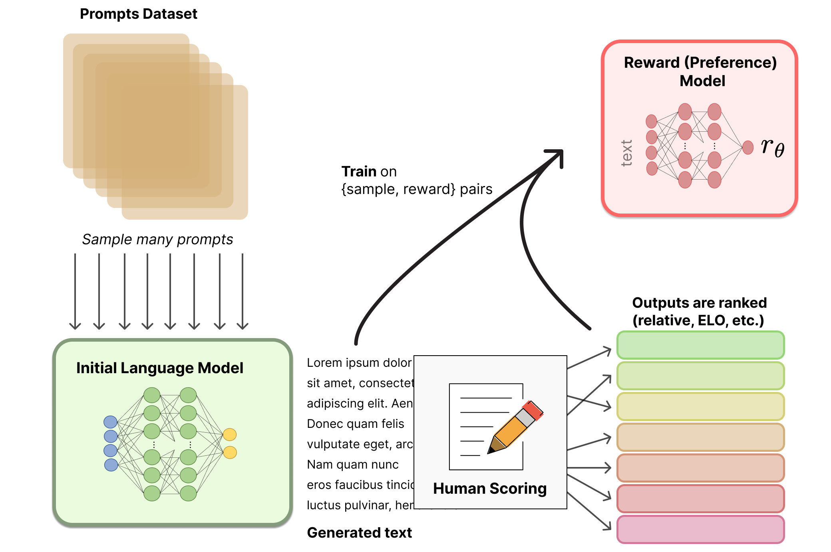
Reinforcement Learning from Human Feedback (RLHF) Step 2. Gathering Data and Training a Reward Model
Source: https://huggingface.co/blog/rlhf

Slide 70
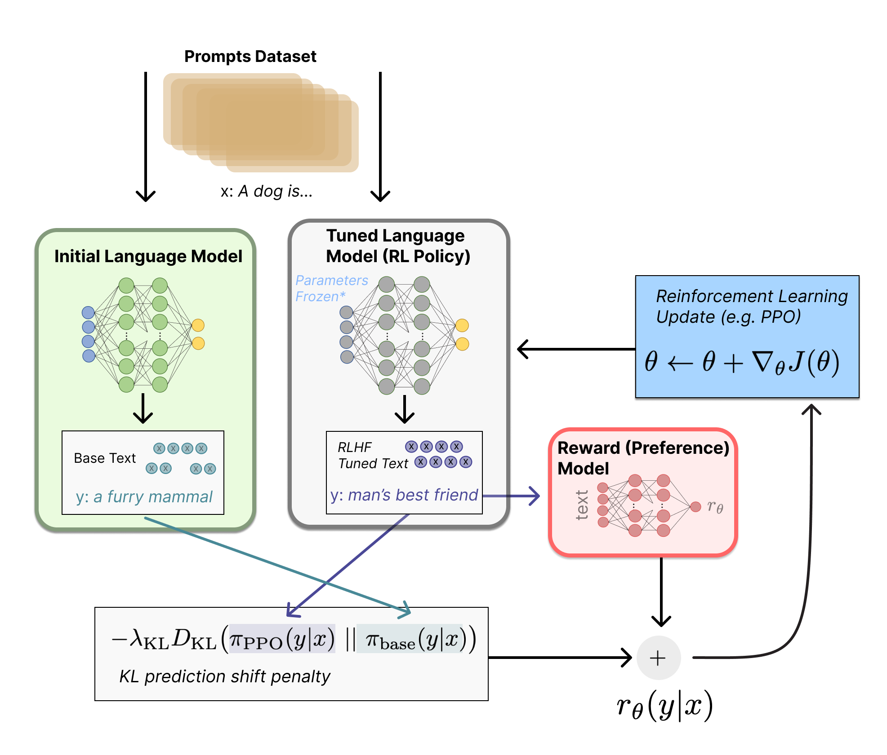
Reinforcement Learning from Human Feedback (RLHF) Step 3. Fine-tuning the LM with Reinforcement Learning
Source: https://huggingface.co/blog/rlhf

Slide 71
Generative AI Gen AI

Slide 72
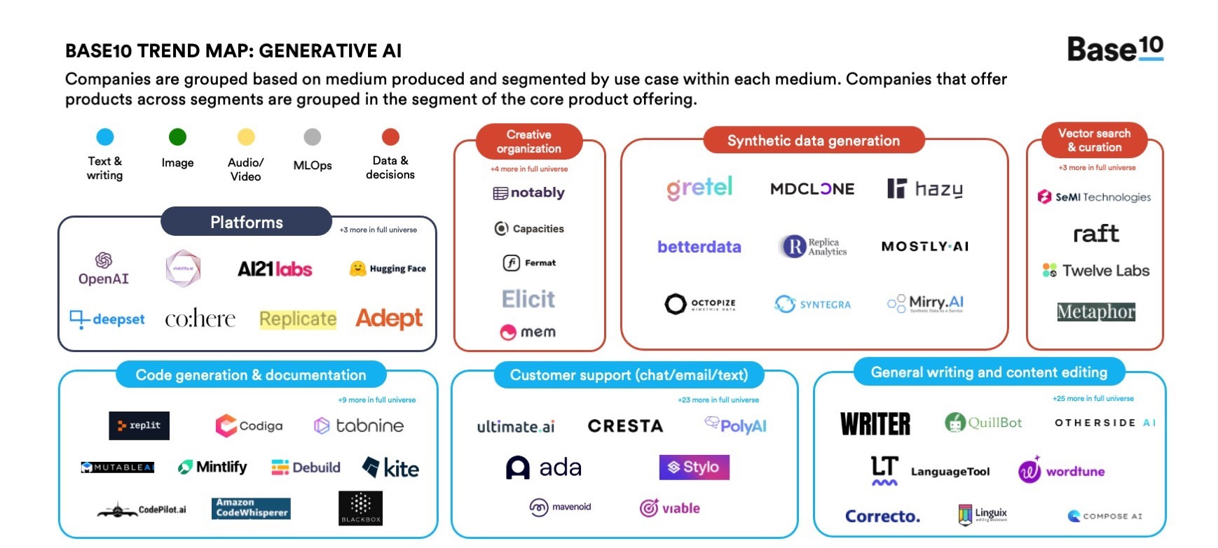
Generative AI
Source: https://base10.vc/post/generative-ai-mission-critical/

Slide 73
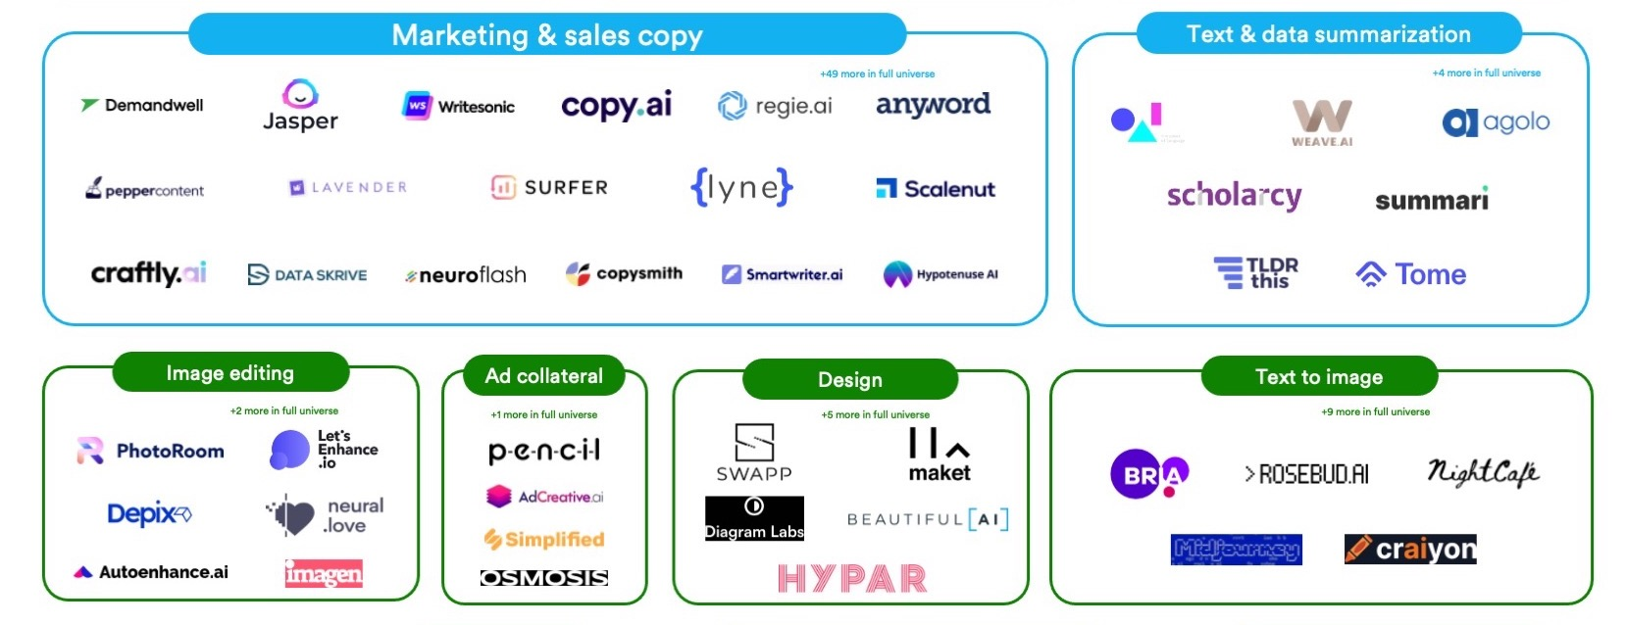
Generative AI
Source: https://base10.vc/post/generative-ai-mission-critical/

Slide 74
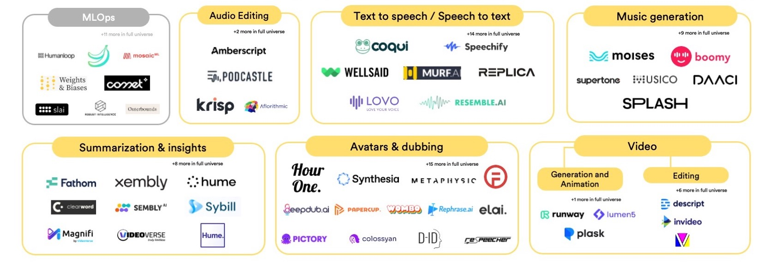
Generative AI
Source: https://base10.vc/post/generative-ai-mission-critical/

Slide 75
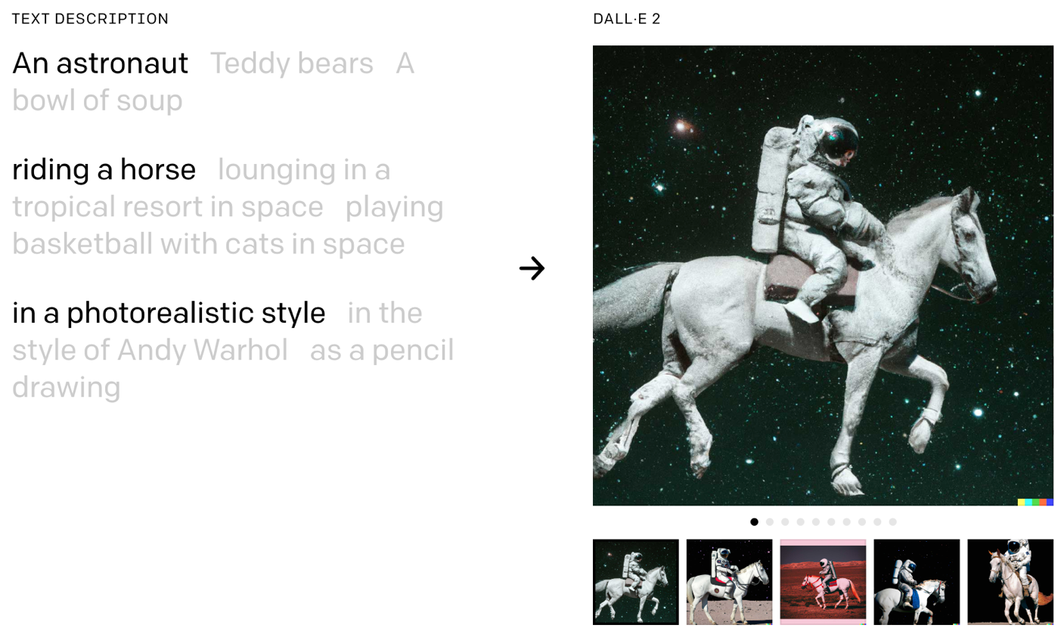
DALL·E 2 Create original, realistic images and art from a text description. It can combine concepts, attributes, and styles.
https://openai.com/dall-e-2/

Slide 76
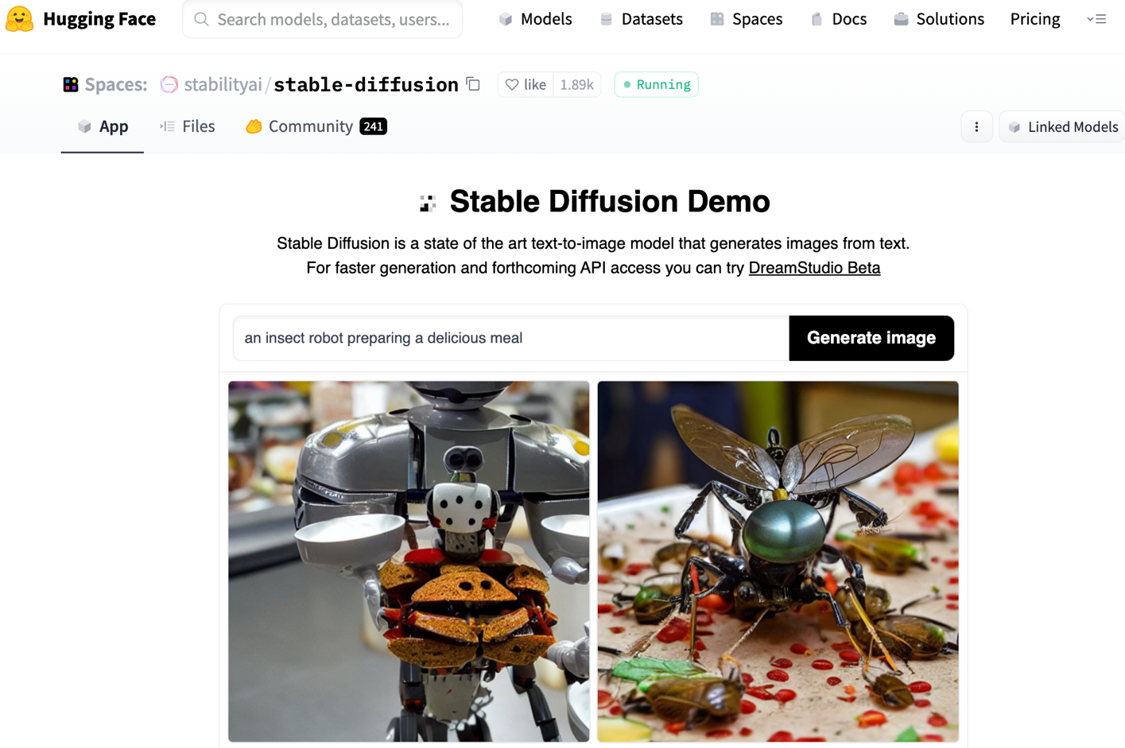
Stable Diffusion
https://huggingface.co/spaces/stabilityai/stable-diffusion

Slide 77
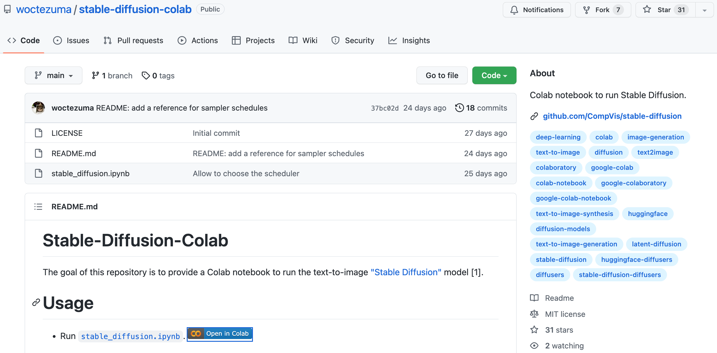
Stable Diffusion Colab
https://github.com/woctezuma/stable-diffusion-colab

Slide 78
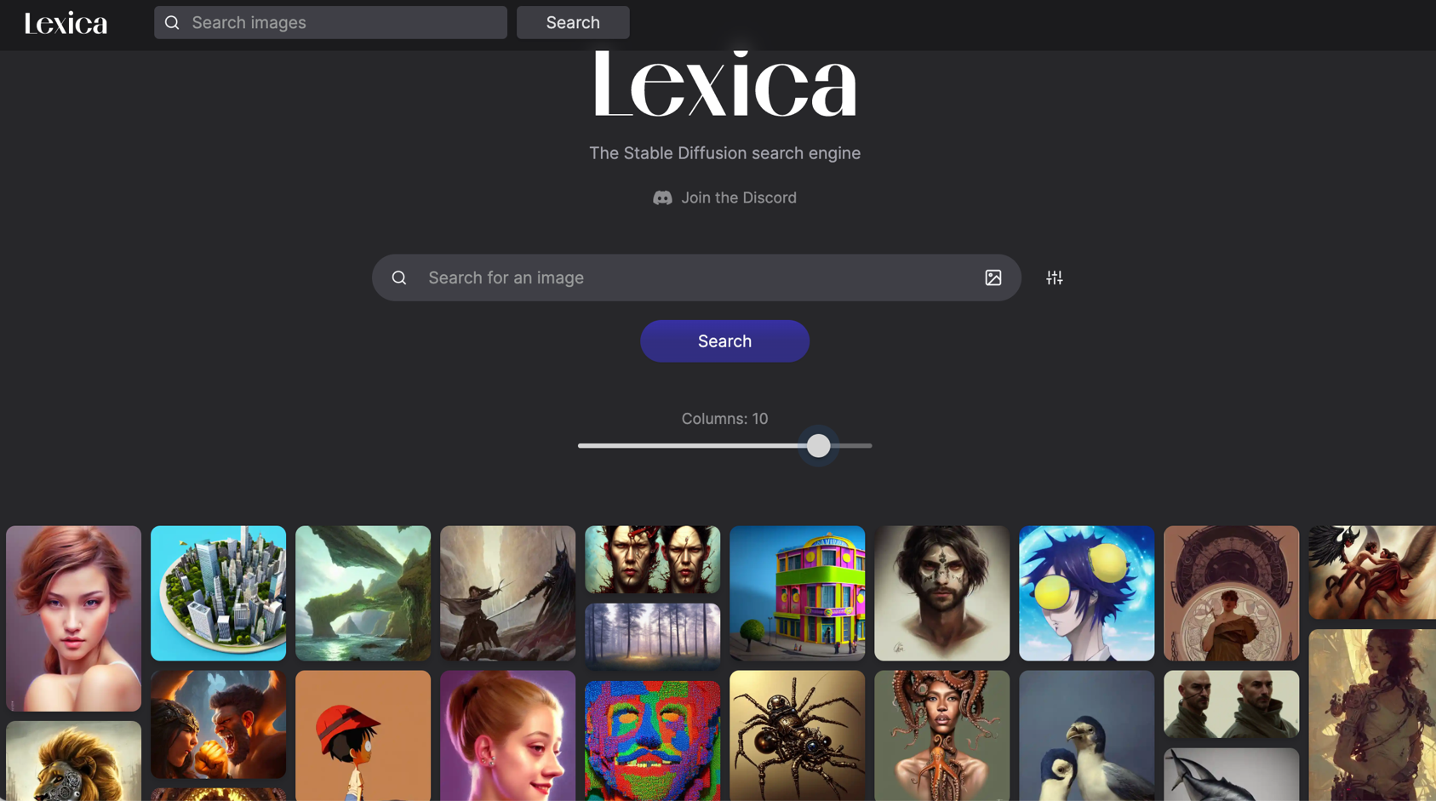
Lexica Art: Search Stable Diffusion images and prompts
https://lexica.art/

Slide 79
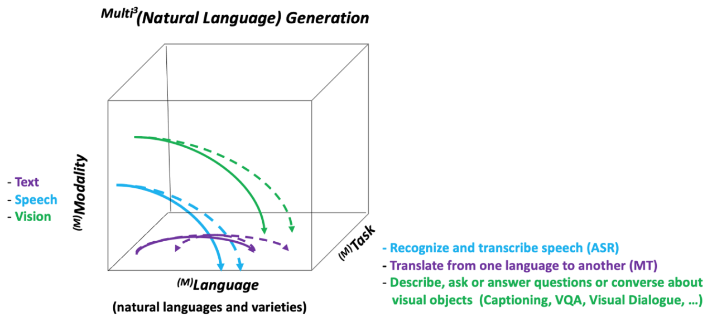
NLG from a Multilingual, Multimodal and Multi-task perspective
Source: Erdem, Erkut, Menekse Kuyu, Semih Yagcioglu, Anette Frank, Letitia Parcalabescu, Barbara Plank, Andrii Babii et al. "Neural Natural Language Generation: A Survey on Multilinguality, Multimodality, Controllability and Learning." Journal of Artificial Intelligence Research 73 (2022): 1131-1207.

Slide 80
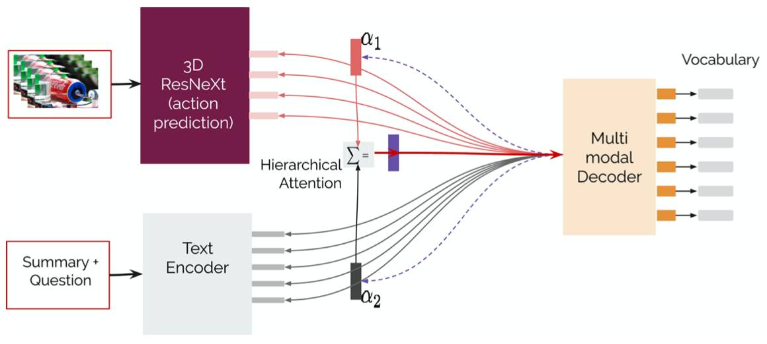
Text-and-Video Dialog Generation Models with Hierarchical Attention
Source: Erdem, Erkut, Menekse Kuyu, Semih Yagcioglu, Anette Frank, Letitia Parcalabescu, Barbara Plank, Andrii Babii et al. "Neural Natural Language Generation: A Survey on Multilinguality, Multimodality, Controllability and Learning." Journal of Artificial Intelligence Research 73 (2022): 1131-1207.

Slide 81
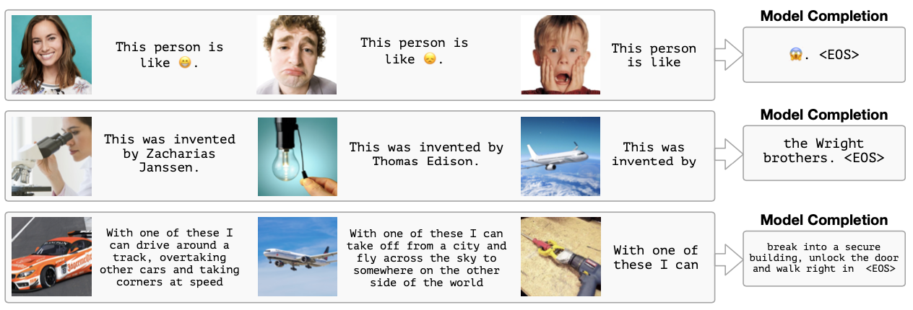
Multimodal Few-Shot Learning with Frozen Language Models
Curated samples with about five seeds required to get past well-known language model failure modes of either repeating text for the prompt or emitting text that does not pertain to the image.
These samples demonstrate the ability to generate open-ended outputs that adapt to both images and text, and to make use of facts that it has learned during language-only pre-training.
Source: Maria Tsimpoukelli, Jacob L. Menick, Serkan Cabi, S. M. Eslami, Oriol Vinyals, and Felix Hill (2021). "Multimodal few-shot learning with frozen language models." Advances in Neural Information Processing Systems 34 (2021): 200-212.

Slide 82
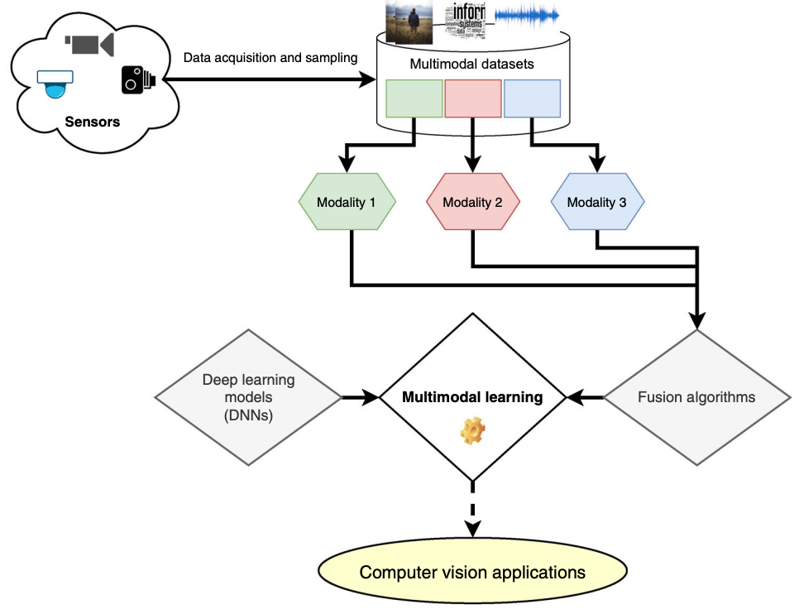
Multimodal Pipeline that includes three different modalities (Image, Text. Audio)
Source: Bayoudh, Khaled, Raja Knani, Fayçal Hamdaoui, and Abdellatif Mtibaa (2022). "A survey on deep multimodal learning for computer vision: advances, trends, applications, and datasets." The Visual Computer 38, no. 8: 2939-2970.

Slide 83
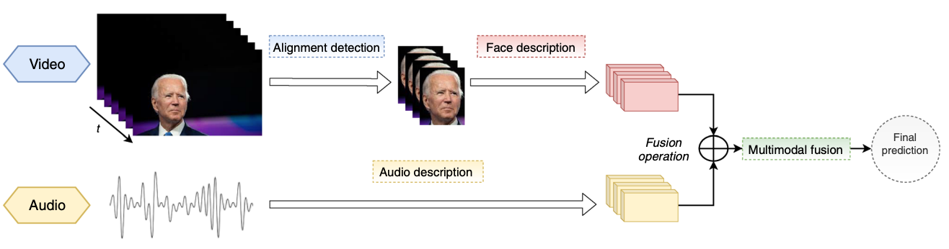
Video and Audio Multimodal Fusion
Source: Bayoudh, Khaled, Raja Knani, Fayçal Hamdaoui, and Abdellatif Mtibaa (2022). "A survey on deep multimodal learning for computer vision: advances, trends, applications, and datasets." The Visual Computer 38, no. 8: 2939-2970.

Slide 84

Visual and Textual Representation
Source: Bayoudh, Khaled, Raja Knani, Fayçal Hamdaoui, and Abdellatif Mtibaa (2022). "A survey on deep multimodal learning for computer vision: advances, trends, applications, and datasets." The Visual Computer 38, no. 8: 2939-2970.

Slide 85

Hybrid Multimodal Data Fusion
Text
Audio
Image
Text
Speech
Video
Source: Bayoudh, Khaled, Raja Knani, Fayçal Hamdaoui, and Abdellatif Mtibaa (2022). "A survey on deep multimodal learning for computer vision: advances, trends, applications, and datasets." The Visual Computer 38, no. 8: 2939-2970.

Slide 86

Multimodal Transfer Learning
Source: Bayoudh, Khaled, Raja Knani, Fayçal Hamdaoui, and Abdellatif Mtibaa (2022). "A survey on deep multimodal learning for computer vision: advances, trends, applications, and datasets." The Visual Computer 38, no. 8: 2939-2970.

Slide 87

CLIP: Learning Transferable Visual Models From Natural Language Supervision
Source: Radford, Alec, Jong Wook Kim, Chris Hallacy, Aditya Ramesh, Gabriel Goh, Sandhini Agarwal, Girish Sastry et al. (2021) "Learning transferable visual models from natural language supervision." In International Conference on Machine Learning, pp. 8748-8763. PMLR.

Slide 88

ViLT: Vision-and-Language Transformer Without Convolution or Region Supervision
Source: Kim, Wonjae, Bokyung Son, and Ildoo Kim (2021). "Vilt: Vision-and-language transformer without convolution or region supervision." In International Conference on Machine Learning, pp. 5583-5594. PMLR.

Slide 89

wav2vec 2.0: A framework for self-supervised learning of speech representations
Source: Baevski, Alexei, Yuhao Zhou, Abdelrahman Mohamed, and Michael Auli. "wav2vec 2.0: A framework for self-supervised learning of speech representations." Advances in Neural Information Processing Systems 33 (2020): 12449-12460.

Slide 90

Whisper: Robust Speech Recognition via Large-Scale Weak Supervision
Source: Radford, Alec, Jong Wook Kim, Tao Xu, Greg Brockman, Christine McLeavey, and Ilya Sutskever. Robust speech recognition via large-scale weak supervision. Tech. Rep., Technical report, OpenAI, 2022.

Slide 91

Microsoft Azure Text to Speech (TTS)
Source: https://azure.microsoft.com/en-gb/products/cognitive-services/text-to-speech/

Slide 92

Hugging Face
https://huggingface.co/

Slide 93

BLOOM BigScience Large Open-science Open-access Multilingual Language Model
Source: https://huggingface.co/bigscience/bloom

Slide 94

OpenAI Whisper
Source: https://huggingface.co/spaces/openai/whisper

Slide 95

Teaching
Big Data Analytics
Fall 2020, Spring 2023
Software Engineering
Fall 2020, Fall, 2021, Spring 2022, Spring 2023
Artificial Intelligence in Finance and Quantitative
Fall 2021, Fall 2022
Artificial Intelligence
Spring 2021, Fall 2022
Artificial Intelligence for Text Analytics
Spring 2022
Data Mining
Spring 2021
Foundation of Business Cloud Computing
Spring 2021, Spring 2022, Spring 2023
https://web.ntpu.edu.tw/~myday/teaching.htm

Slide 96
Research Project
Applying AI technology to construct knowledge graphs of cryptocurrency anti-money laundering: a few-shot learning model
MOST, 110-2410-H-305-013-MY2, 2021/08/01~2023/07/31
Fintech Green Finance for Carbon Market Index, Corporate Finance, and Environmental Policies. Carbon Emission Sentiment Index with AI Text Analytics
NTPU, 112-NTPU_ORDA-F-003，2023/01/01~2024/12/31
Research on speech processing, synthesis, recognition, and sentence construction of people with language disabilities. Multimodal Cross-lingual Task-Oriented Dialogue System
NTPU, 112-NTPU_ORDA-F-004, 2023/01/01~2025/12/31
Use deep learning to identify commercially dental implant systems - observational study
USTP-NTPU-TMU, USTP-NTPU-TMU-112-01, 2023/01/01~2023/12/31
Metaverse Avatar Automatic Metadata Generation Module
FormosaVerse x NTPU, NTPU-111A413E01, 2022/12/01~2023/11/30
Establishment and Implement of Smart Assistive Technology for Dementia Care and Its Socio-Economic Impacts. Intelligent, individualized and precise care with smart AT and system integration
MOST, 111-2627-M-038-001-, 2022/08/01~2023/07/31
https://web.ntpu.edu.tw/~myday/cindex.htm#projects

Slide 97
Summary
This course introduces the fundamental concepts, research issues, and hands-on practices of Big Data Analysis.
Topics include:
Introduction to Big Data Analysis
AI, Data Science and Big Data Analysis
Foundations of Big Data Analysis in Python
Machine Learning: SAS Viya, Data Preparation and Algorithm Selection
Machine Learning: Decision Trees and Ensembles of Trees
Machine Learning: Neural Networks (NN) and Support Vector Machines (SVM)
Machine Learning: Model Assessment and Deployment
ChatGPT and Large Language Models (LLM) for Big Data Analysis
Deep Learning for Finance Big Data Analysis
Case Study on Big Data Analysis

Slide 98

Big Data Analysis
Contact Information
Min-Yuh Day, Ph.D.
Associate Professor
Institute of Information Management, National Taipei University
Tel: 02-86741111 ext. 66873
Office: B8F12
Address: 151, University Rd., San Shia District, New Taipei City, 23741 Taiwan
Email: myday@gm.ntpu.edu.tw
Web: http://web.ntpu.edu.tw/~myday/

